Slide 1
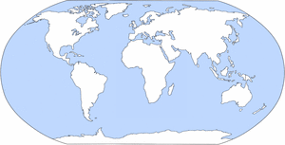
Arctic Ocean
North America
Europe
Asia
Atlantic Ocean
Pacific Ocean
Africa
South America
Indian Ocean
Australia
Southern Ocean
Antarctica

